Slide 1
[ 5th week Report ]
Researching Project
“ Soil Ph meter Design ”
Lecturer: Hel Chanthan
By: Nhim ChanRengSey
2019-2020

Slide 2
Outline
Operational amplifier Summary:
Inverting Op-Amp
Non-Inverting Op-Amp
Summing amplifier
Differential amplifier
Op-amp as Integrator
Op-amp as Differentiator
Next step of project:
choosing Sensor and LCD
Design PCB
Testing hardware
Learn STM32 coding
Drawing Case for hardware
Missing and difficulty

Slide 3
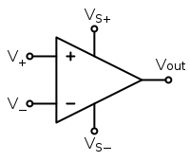
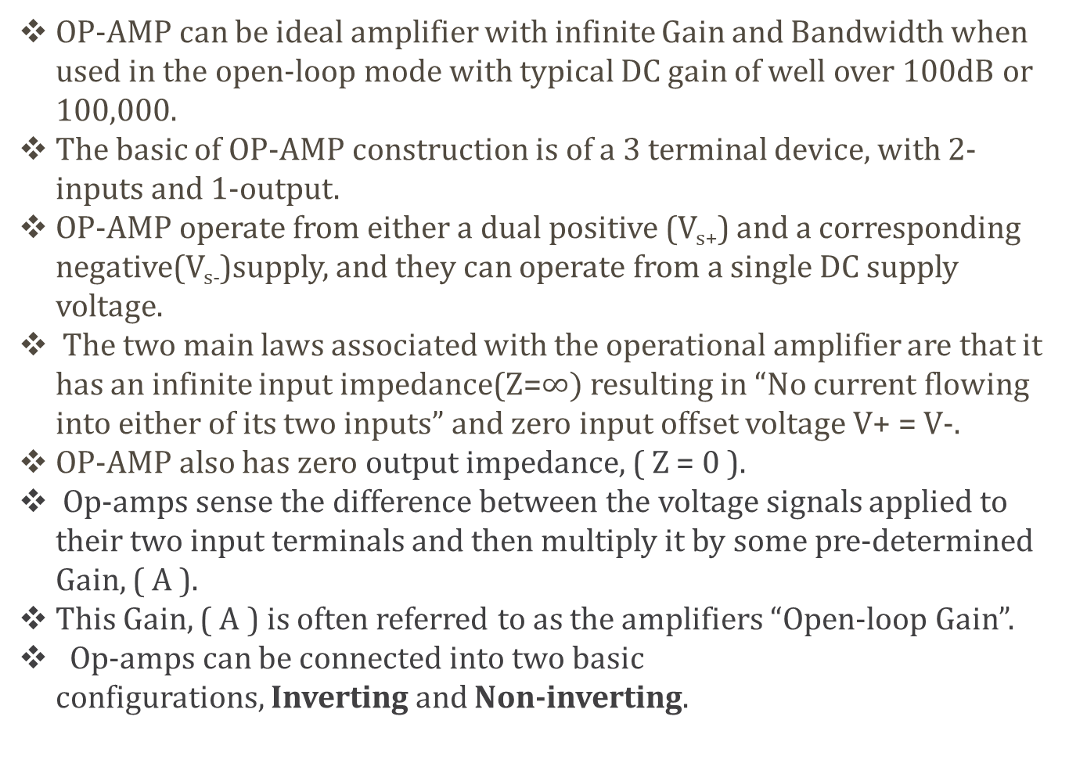
Operational Amplifier Summary
OP-AMP can be ideal amplifier with infinite Gain and Bandwidth when used in the open-loop mode with typical DC gain of well over 100dB or 100,000.
The basic of OP-AMP construction is of a 3 terminal device, with 2-inputs and 1-output.
OP-AMP operate from either a dual positive (V_{s+}) and a corresponding negative(V_{s-})supply, and they can operate from a single DC supply voltage.
The two main laws associated with the operational amplifier are that it has an infinite input impedance(Z=$∞)$resulting in “No current flowing into either of its two inputs” and zero input offset voltage V+ = V-.
OP-AMP also has zero output impedance, ( Z = 0 ).
Op-amps sense the difference between the voltage signals applied to their two input terminals and then multiply it by some pre-determined Gain, ( A ).
This Gain, ( A ) is often referred to as the amplifiers “Open-loop Gain”.
Op-amps can be connected into two basic configurations, Inverting and Non-inverting.
Non-Inverting terminal
Inverting terminal
Input
Output
Page: 01

Slide 4
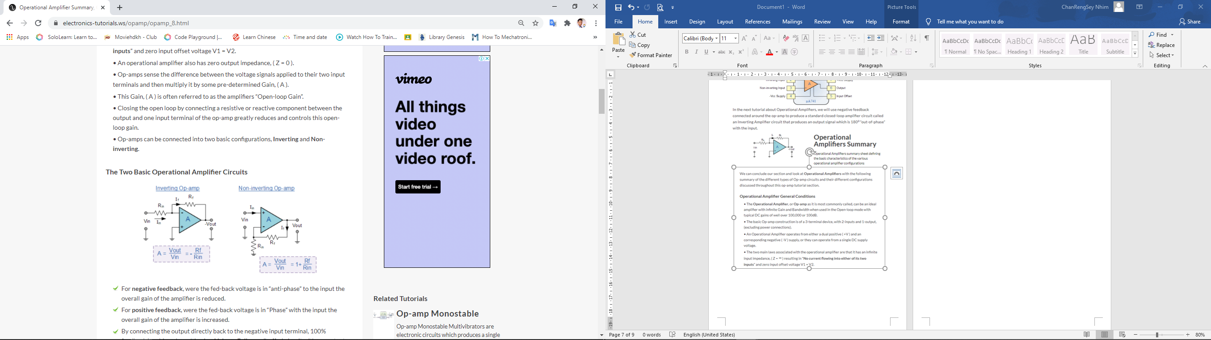
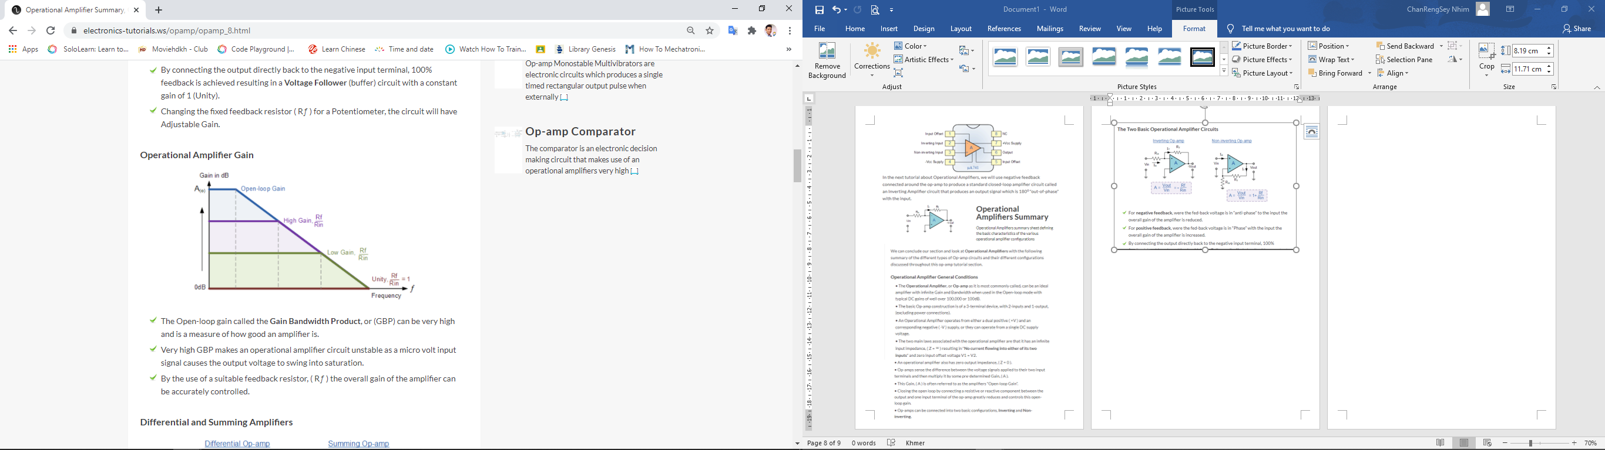
Operational Amplifier Summary
Page: 02

Slide 5
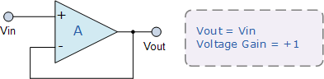
Operational Amplifier Summary
Page: 03

Slide 6
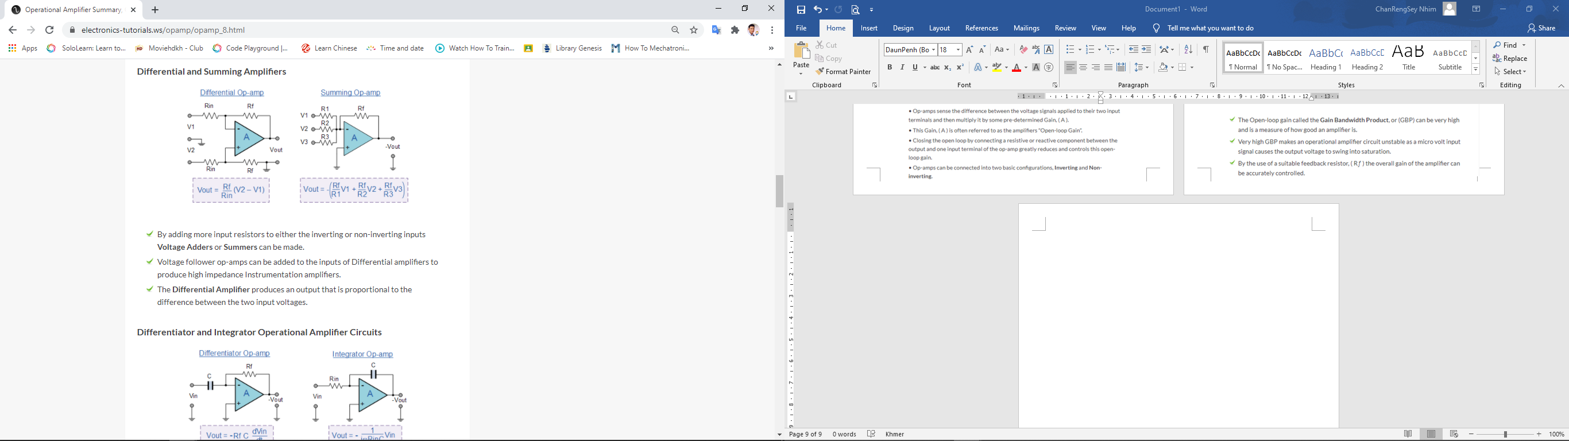
Operational Amplifier Summary
Differential and summing amplifier
Page: 04

Slide 7
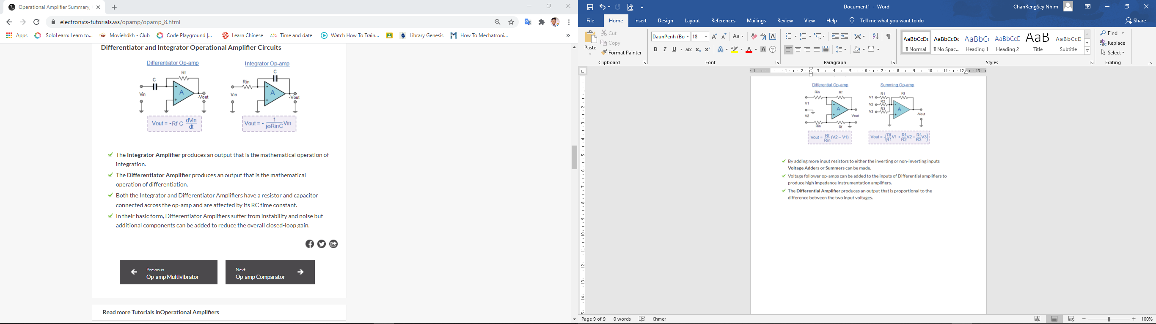
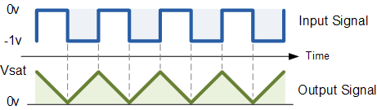
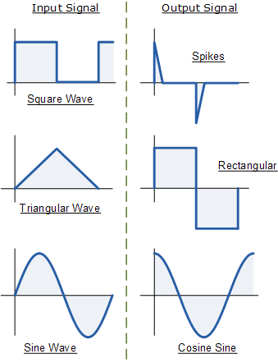
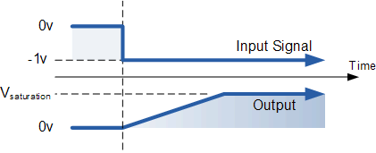
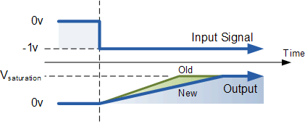
Operational Amplifier Summary
Page: 05

Slide 8
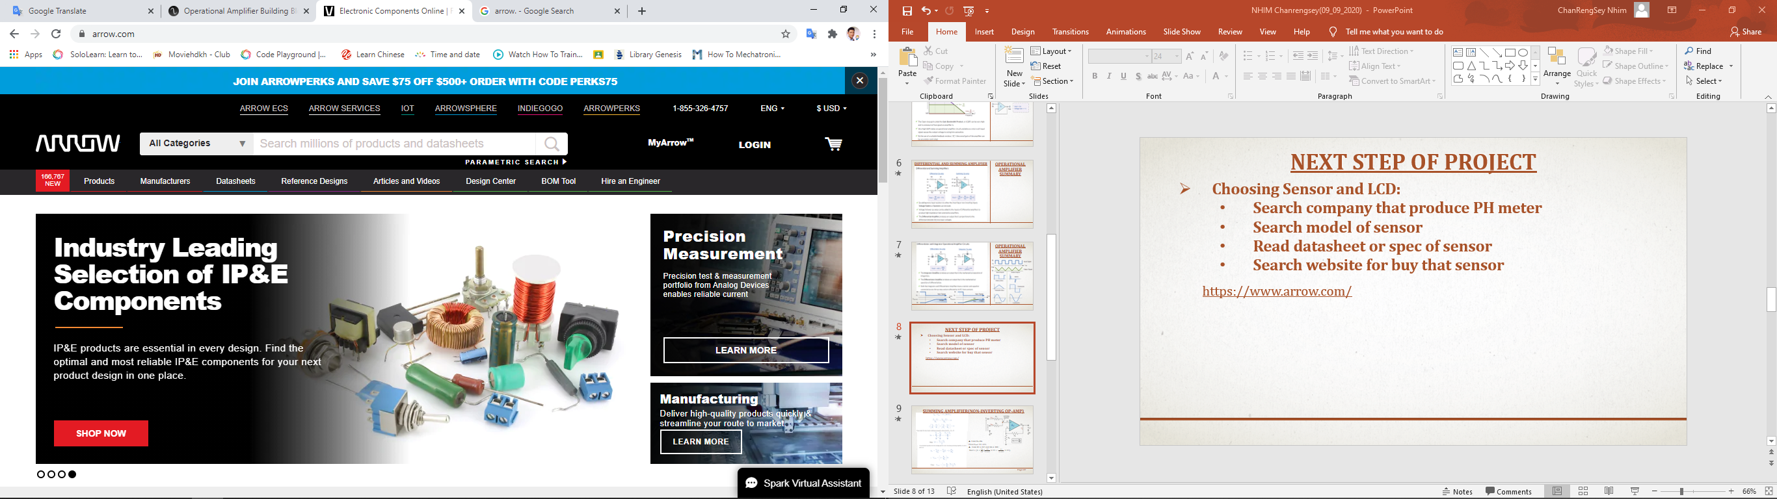
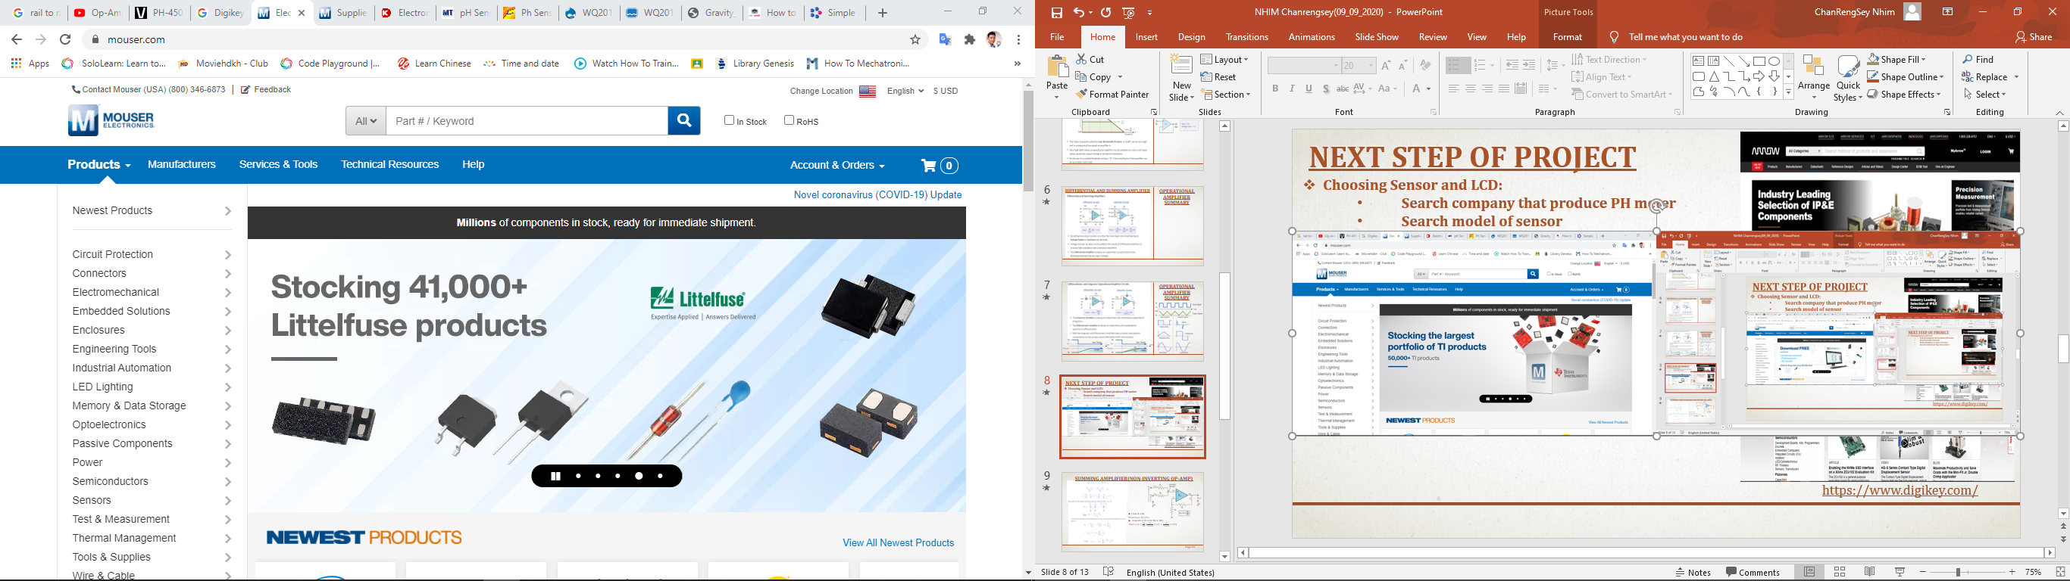
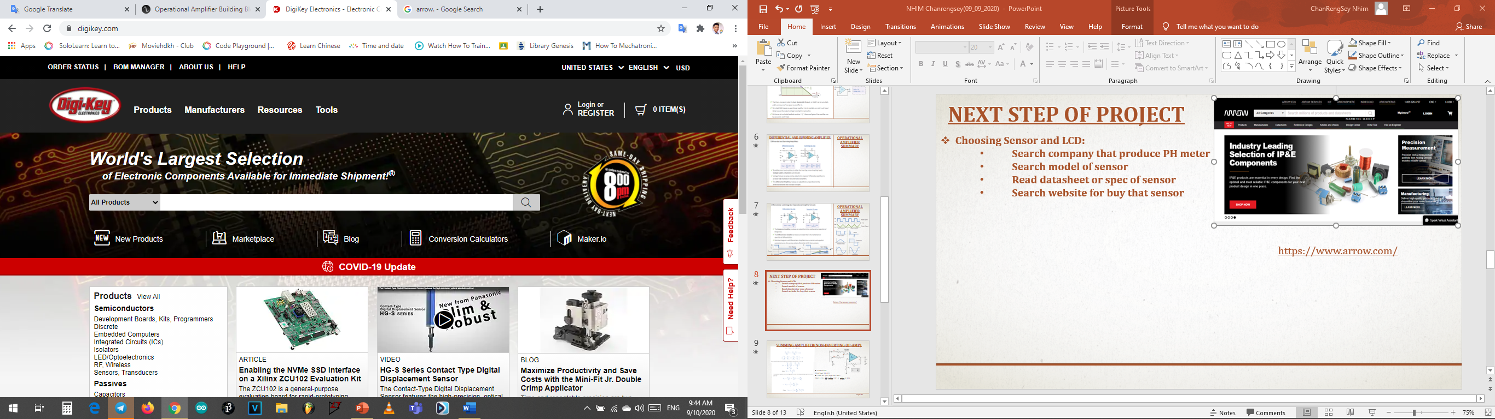
Next step of Project
Choosing Sensor and LCD:
Search company that produce PH meter
Search model of sensor
Read datasheet or spec of sensor
Search website for buy that sensor
https://www.arrow.com/
https://www.mouser.com/
https://www.digikey.com/
Page: 06

Slide 9

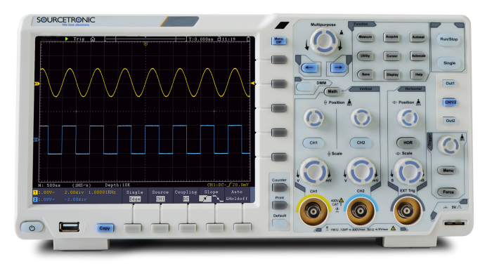


Next step of Project
Design PCB:
Use KiCad for design PCB
Design an Amplifier and a filter Circuit
Testing Hardware:
After finish of design PCB already we must test it in oscilloscope to make sure it work clearly or not.
Learn STM32 code:
Use STM32CubeIDE 1.3.0
Learn how to use ADC of STM32
Learn how to use Display with STM32
Integrate code in STM32
Assemble and Install STM32 with Circuit on PCB:
Testing STM32 with sensor and LCD
Drawing and print case for hardware:
Use Fusion 360 for draw case.
Use 3D printer for print.
Page: 07

Slide 10
Difficulty and Missing
Difficulty :
Hard to research about PH sensor.
Missing:
Lately work
Page: 08

Slide 11
Planning for 2nd month
Week | Monday | Tuesday | Wednesday | Thursday | Friday | Goal
5th Week | Build Filter pH & LCD | Meeting Build Filter | Filter Build filter | Presentation Build Amp | Build Amplifier | Design Amplifier
6th Week | Build Amplifier | Meeting Learn stm32 | Learn STM32 Test LCD/pH | Presentation Write Code | Write Code STM32 | Start STM32
7th Week | Write Code STM32 | Meeting Write Code | Write Code STM32 | Presentation Write code | Finish STM32 Code | Finish STM32 Code
8th Week | Draw case for hardware | Meeting Draw case | Draw case for hardware | Presentation Draw case | Print 3D case | Build case Finish Job
Start : 06/09/2020
Page: 09

Slide 12
THANK YOU

